Slide 1
Image Steganography
CAPSTONE PROJECT
Presented By: Mithilesh Reddy S
Student Name : Mithilesh Reddy S
College Name & Department : JNTUA College of Engineering, Anantapur & M.Tech (Computer Science)

Slide 2
OUTLINE
Problem Statement
Technology used
Wow factor
End users
Result
Conclusion
Git-hub Link
Future scope

Slide 3
Problem Statement
This project aims to securely hide and retrieve secret messages within images using steganography and encryption. The tool provides a user-friendly GUI to facilitate message embedding and extraction with password protection. It ensures secure communication by encrypting messages before hiding them in images. Users can decrypt the message only with the correct password, ensuring confidentiality and security.

Slide 4
Technology used
Python 🐍 – The backbone of secure image steganography.
Tkinter 🖥️ – Simplifying user interaction with an intuitive GUI.
Cryptography 🔐 – Ensuring message security with strong encryption.
OpenCV 📸 – Embedding and extracting messages from images efficiently.
NumPy 🔢 – Handling data seamlessly for pixel-level manipulation.
Git & GitHub 🚀 – Managing version control for collaboration and improvements.

Slide 5
Wow factors
🔐 Dual-Layer Security – Combines steganography & encryption for enhanced protection.
🖼️ Invisible Embedding – Hides messages seamlessly within images without altering appearance.
⚡ User-Friendly GUI – Split-screen design for easy encryption & decryption.
✅ Password-Protected Access – Only the correct password reveals the hidden message.
🛠️ Error Handling – Detects incorrect passwords & corrupted images.
🌍 Lightweight & Fast – Works efficiently without heavy processing requirements.

Slide 6
End users
🕵️ Journalists & Whistleblowers – Securely share confidential information.
🏛️ Government & Intelligence Agencies – Protect classified communications.
📧 Corporate Professionals – Safeguard sensitive business data.
🏦 Banking & Finance Sector – Encrypt financial transactions and reports.
🎭 Artists & Content Creators – Watermark and protect digital assets.
📡 Cybersecurity Enthusiasts – Experiment with advanced encryption techniques.

Slide 7
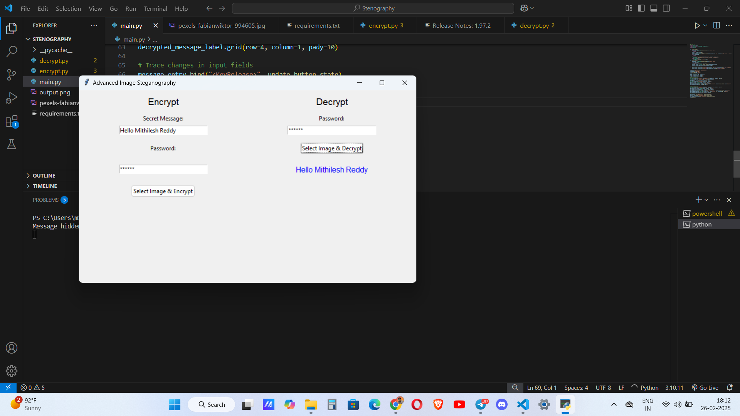
Results

Slide 8
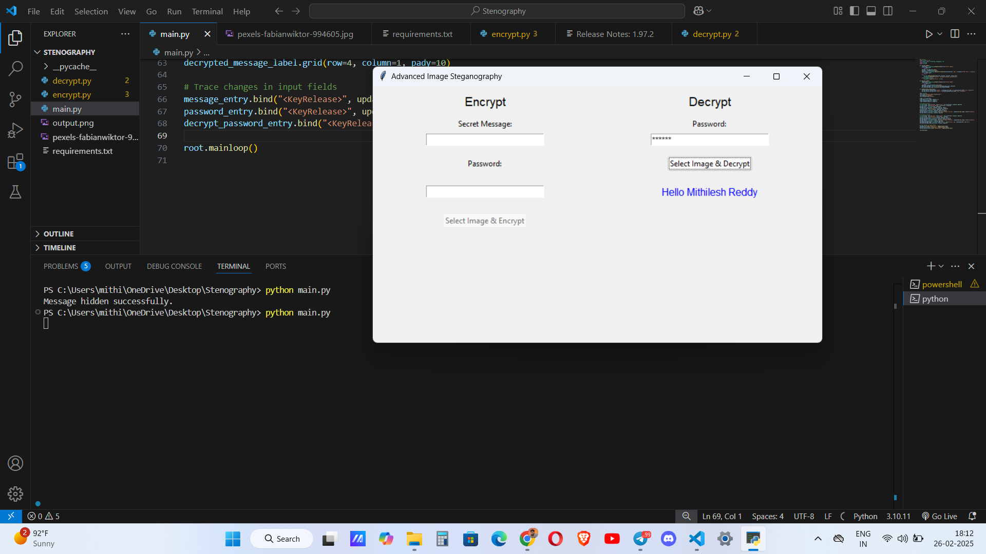
Results

Slide 9
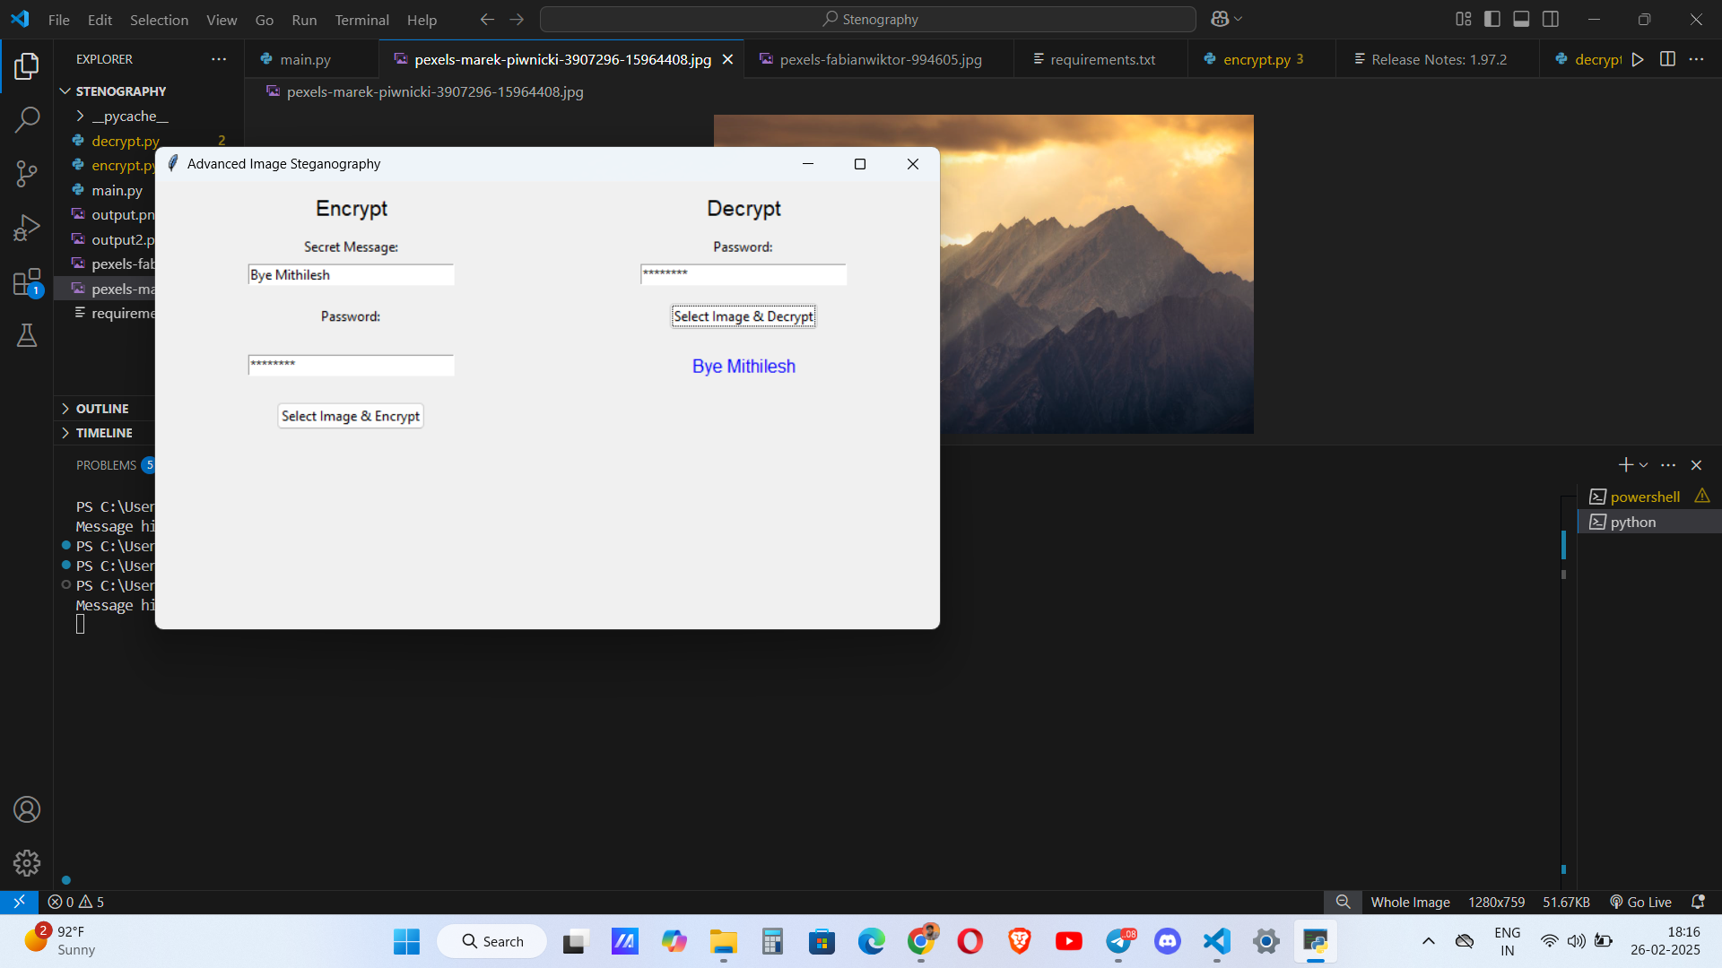
Results

Slide 10

Results

Slide 11

Results

Slide 12
Conclusion
This project successfully implements a secure and user-friendly image steganography tool that combines encryption and steganography for enhanced data protection. The intuitive graphical interface makes it accessible for users to hide and retrieve messages efficiently. With practical applications in cybersecurity, journalism, corporate communications, and government sectors, this tool provides a reliable method for secure data transfer.

Slide 13
GitHub Link
https://github.com/mithilreddy369/Image-Steganography username – mithilreddy369

Slide 14
Future scope(optional)
AI-Powered Steganalysis – Implement machine learning techniques to detect and prevent unauthorized steganography.
Mobile Application Development – Extend functionality to Android and iOS for on-the-go secure messaging.
Support for Multiple File Formats – Enhance compatibility to hide messages in audio and video files.
Cloud-Based Encryption & Storage – Integrate cloud services for remote encryption and decryption.
Blockchain Integration – Utilize blockchain for decentralized and tamper-proof message authentication.
Improved Encryption Techniques – Enhance security with advanced cryptographic algorithms.

Slide 15
THANK YOU

